Slide 1
A Distributed Platform for Image-Based Giardia Analysis
Kyle Gronich, Zhao Yang

Slide 2
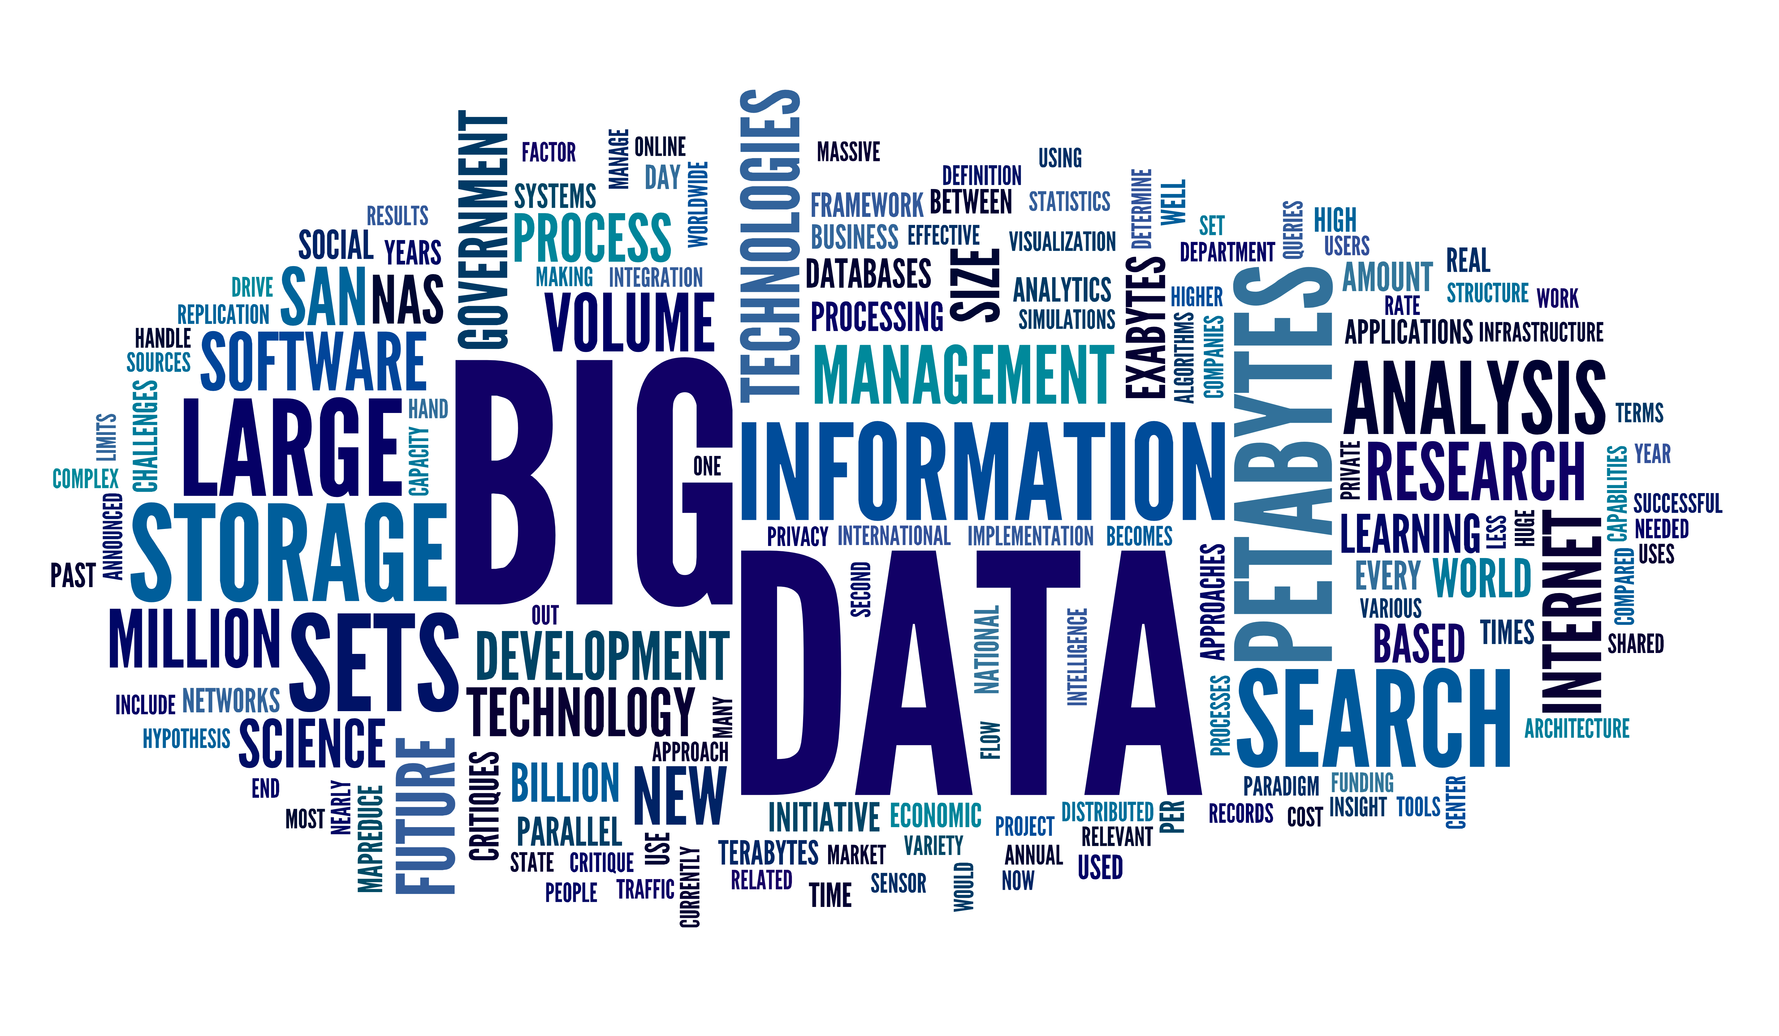
Introduction and Motivation
Emergence of big data
Rapidly-evolving digital processing projects
Unique software implementations
Goal: significant runtime reduction with minimal code adaptation
Image from: http://olap.com/big-data/

Slide 3
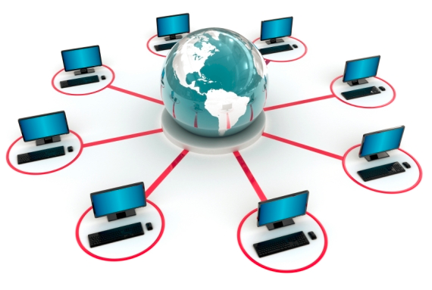
Existing Solutions
Custom Compiler
Pipeline Software Packages
Cluster
High Performance Computing (HPC) Software
Image from: http://www.kgionline.com/distributed-computing.jpg
Notes:
Look up LONI
Existing cluster – set of networked computers seen as single machine by the sofware; 1. availability, 2. flexibility (changing code)
HPC software – 1. flexibility to reuse code

Slide 4
Distributed Platform Overview
Raw Image(s)
Splitting Script(s)
Processing Script(s)
Joining Script(s)
Distributed
Platform
Merged Result(s)
Distributed platform is written in Python and utilizes the Twisted Engine

Slide 5
The Distributed Platform in Detail
Raw Image(s)
Splitting Script
Processing Script
Joining Script
User
Interface

Slide 6
The Distributed Platform in Detail
User
Interface
Central
Server
Raw Image(s)
Splitting Script
Processing Script
Joining Script

Slide 7
The Distributed Platform in Detail
User
Interface
Central
Server
Raw Image(s) → N Jobs
Splitting Script
Processing Script
Joining Script

Slide 8
The Distributed Platform in Detail
User
Interface
Central
Server
Raw Image(s) → N Jobs
Splitting Script
Processing Script
Joining Script
. . .
Worker 1
Worker 2
Worker 3
Worker N
Job 1
Processing Script
Job 2
Processing Script
Job 2
Processing Script
Job N
Processing Script

Slide 9
The Distributed Platform in Detail
User
Interface
Central
Server
Raw Image(s) → N Jobs
Splitting Script
Processing Script
Joining Script
. . .
Worker 1
Worker 2
Worker 3
Worker N
Job 1 → Result 1
Processing Script
Job 2 → Result 2
Processing Script
Job 2 → Result 3
Processing Script
Job N → Result N
Processing Script

Slide 10
The Distributed Platform in Detail
User
Interface
Central
Server
Raw Image(s) → N Jobs
Splitting Script
Processing Script
Joining Script
Result 1,2,…,N
. . .
Worker 1
Worker 2
Worker 3
Worker N
Job 1 → Result 1
Processing Script
Job 2 → Result 2
Processing Script
Job 2 → Result 3
Processing Script
Job N → Result N
Processing Script

Slide 11
The Distributed Platform in Detail
User
Interface
Central
Server
Raw Image(s) → N Jobs
Splitting Script
Processing Script
Joining Script
Result 1,2,…,N → Merged Result
. . .
Worker 1
Worker 2
Worker 3
Worker N

Slide 12
The Distributed Platform in Detail
User
Interface
Central
Server
Splitting Script
Processing Script
Joining Script
Merged Result
. . .
Worker 1
Worker 2
Worker 3
Worker N

Slide 13
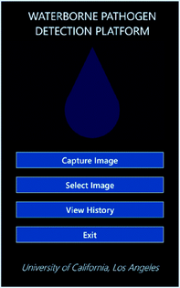
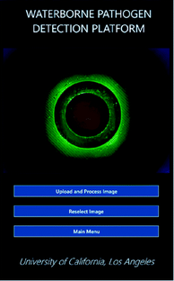
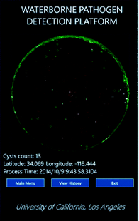
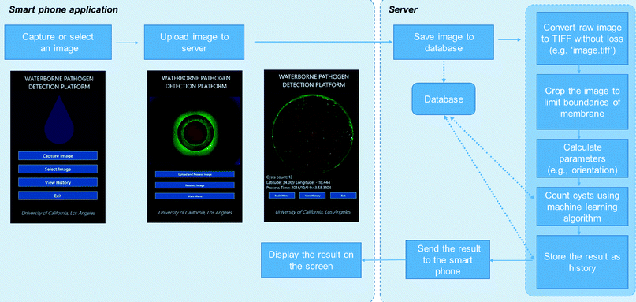
Case Study: Giardia
The Window phone app interface of Giardia

Slide 14
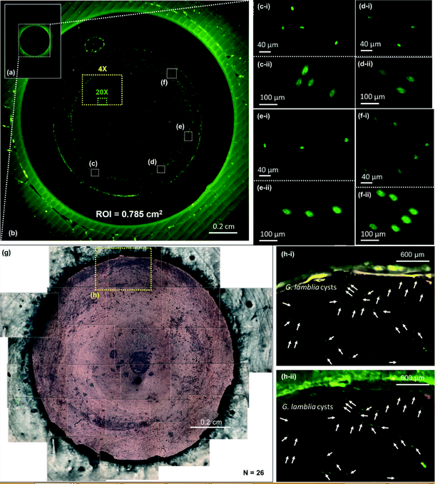
Case Study: Giardia
The comparison of results between Giardia and the standard benchtop microscope

Slide 15
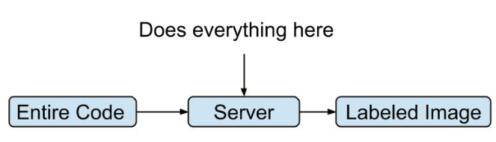
Distributed Computing on Giardia

Slide 16
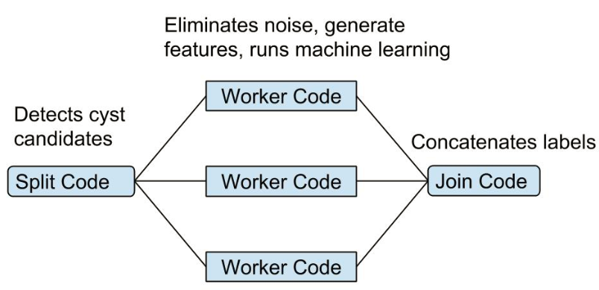
Distributed Computing on Giardia

Slide 17
MATLAB Interface of Giardia
function [] = split (filename, num_of_machines, output)
function [] = process (input_file, output_file)
function [] = join (num_of_machines, output_name, filename)

Slide 18
Performance
For our testing, we used an image with 10 Giardia lamblia cysts captured on the membrane.

Slide 19
Conclusion
Current State:
Built platform
Web interface
Tested on giardia
Central
Server
Worker 1
Worker 2
Shared
Directory
Next Steps:
Shared file system
Incorporation with additional projects

